Slide 1
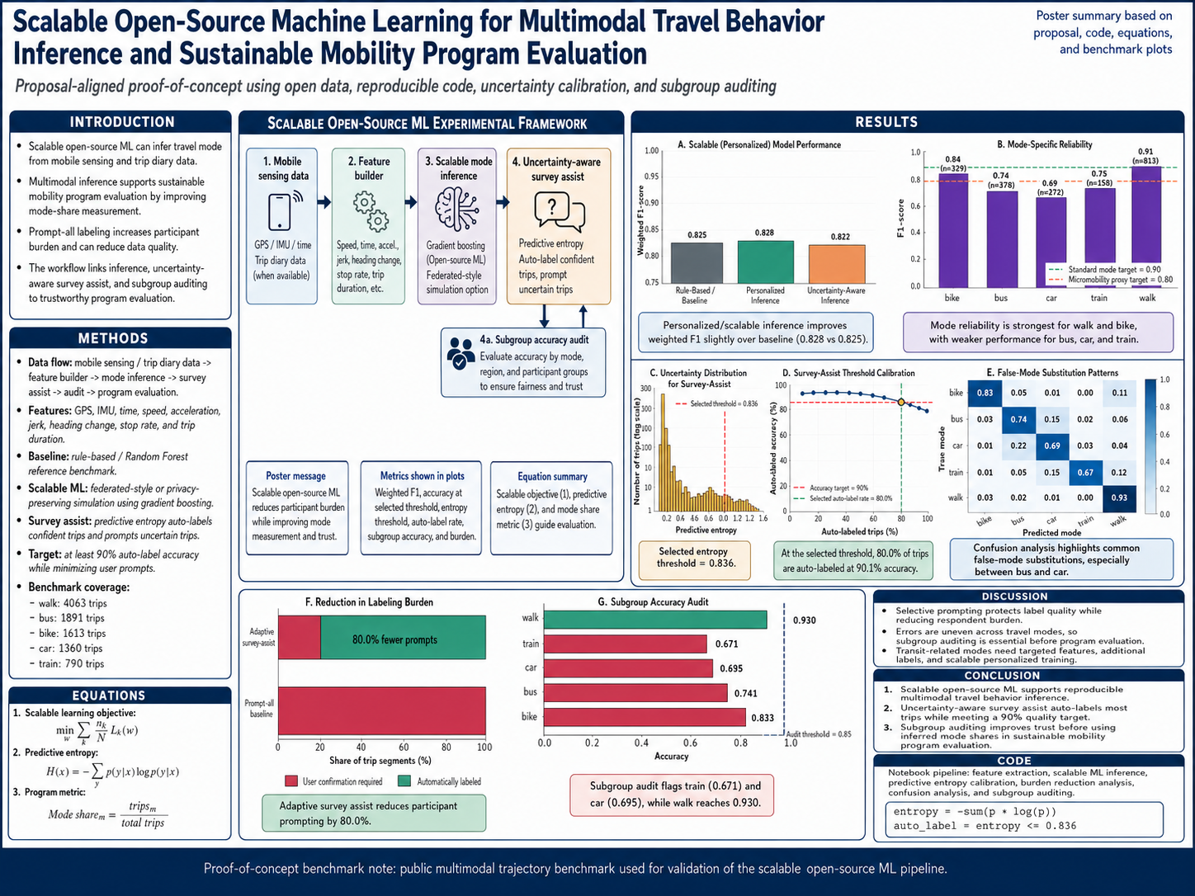




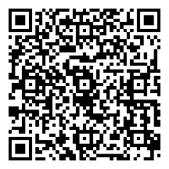

Scalable Open-Source Machine Learning for Multimodal Travel Behavior Inference and Sustainable Mobility Program Evaluation
Scalable Open-Source Machine Learning for Multimodal Travel Behavior Inference and Sustainable Mobility Program Evaluation
Faysal Chowdhoury, Advisor: Dr. K. Shankari and Dr. Mahyar Amirgholy
Faysal Chowdhoury, Advisor: Dr. K. Shankari and Dr. Mahyar Amirgholy
https://github.com/faysalchowdhoury/multimodal-travel-behavior-sustainable-mobility
Data Source:
NLR OpenPATH- Open Platform for Agile Trip Heuristics

